Slide 1
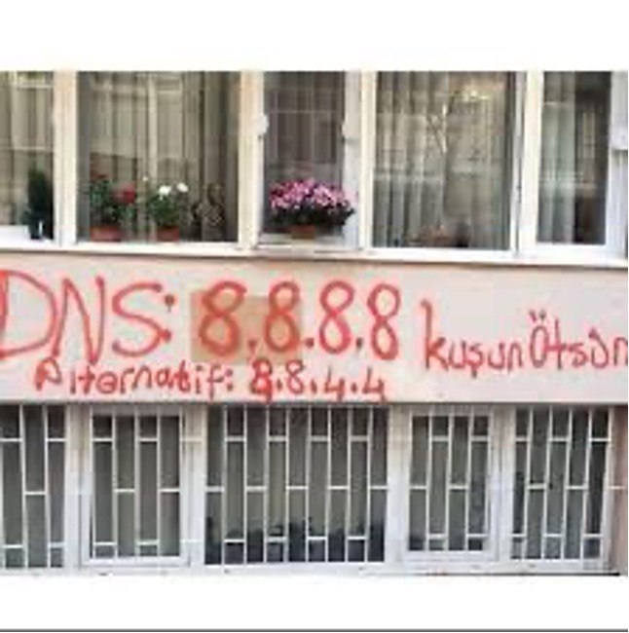
DNS Security Vitaly Shmatikov

Slide 2

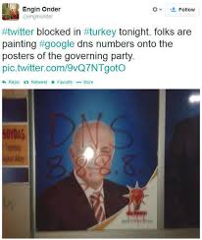
Turkey (2014)

Slide 3

The hacking group, called Turkguvenligi, targeted the net's Domain Name System (DNS)
Turkguvenligi revealed that it got access to the files using a well-established attack method known as SQL injection

Slide 4
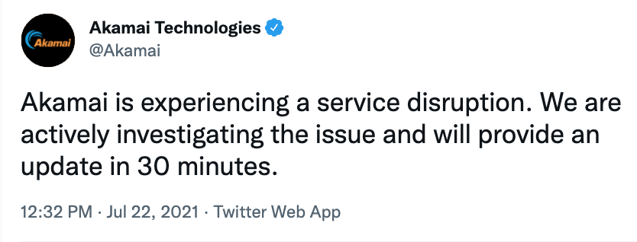
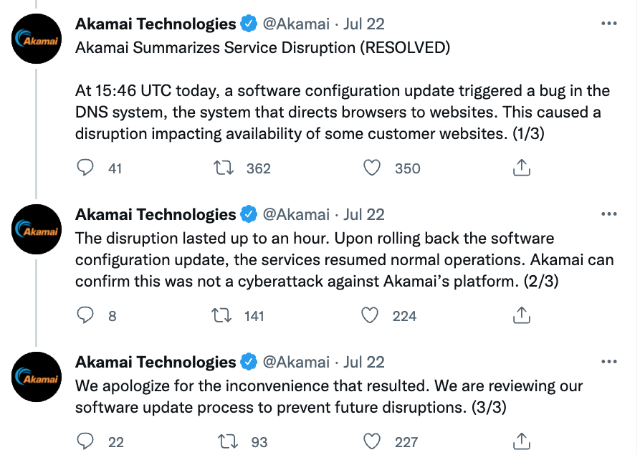
Airbnb, Salesforce, Home Depot, UPS, British Airways, Sony PlayStation network offline for an hour
Not a security issue,
apparently…

Slide 5
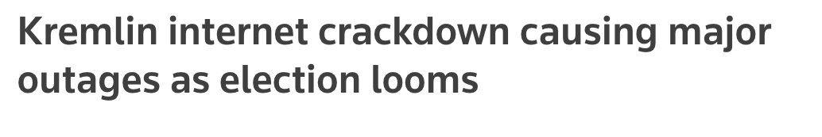

September 10, 2021
There had been widespread disruption after Roskomnadzor blocked widely-used internet services in its bid to prevent access to a banned app backed by Navalny’s allies…
Roskomnadzor blocked Google and cybersecurity firm Cloudflare’s domain name system (DNS) services, which computers use to match website addresses with the correct servers.
https://www.reuters.com/article/us-russia-politics-internet-idCAKBN2G61MA

Slide 6
DNS Hostname vs. IP Address
DNS hostname (e.g., www.cs.cornell.edu)
Mnemonic name understood by humans
Variable length, full alphabet of characters
Provides little (if any) information about location
IP address (e.g., 128.84.202.53)
Numerical address understood by routers
Fixed length, decimal number
Hierarchical address space, related to host location

Slide 7
Uses of DNS
Hostname to IP address translation
Reverse lookup: IP address to hostname translation
Host name aliasing: other DNS names for a host
Alias hostnames point to canonical hostname
Email: look up domain’s mail server by domain name

Slide 8
Different DNS Mappings
1-1 mapping between domain name and IP addr
www.cs.cornell.edu maps to 132.236.207.20
Multiple domain names maps to the same IP addr
eecs.mit.edu and cs.mit.edu both map to 18.62.1.6
Single domain name maps to multiple IP addrs
aol.com and www.aol.com map to multiple IP addrs
Some valid domain names don’t map to any IP addr
cmcl.cs.cmu.edu

Slide 9
Goals of DNS
A wide-area distributed database
Possibly biggest such database in the world!
Goals
Scalability; decentralized maintenance
Robustness
Global scope
Names mean the same thing everywhere
Distributed updates/queries
Good performance

Slide 10
DNS Structure
Hierarchical name space divided into contiguous sections called zones
Zones are distributed over a collection of DNS servers
Hierarchy of DNS servers
Root servers (identity hardwired into other servers)
Top-level domain (TLD) servers
Authoritative DNS servers
Performing the translations
Local DNS servers located near clients
Resolver software running on clients

Slide 11
Hierarchical Structure of DNS
.
Root
TLDs
com.
gov.
edu.
fcc.gov.
cornell.edu.
nyu.edu.
cs.cornell.edu.
Hierarchy of namespace matches hierarchy of servers
Set of nameservers answers queries for names within zone
Nameservers store names and links to other servers in tree

Slide 12
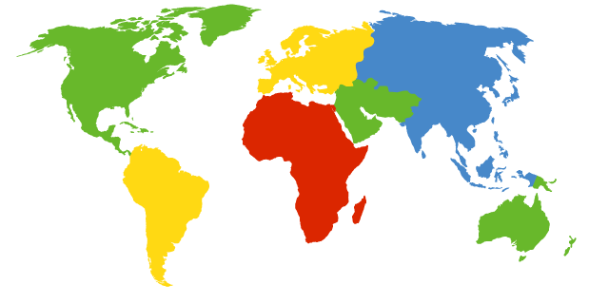
13 DNS Root Nameservers
Feb 6, 2007: Botnet DoS attack on
root DNS servers
A Verisign, Dulles, VA
C Cogent, Herndon, VA
D U Maryland College Park, MD
G US DoD Vienna, VA
H ARL Aberdeen, MD
J Verisign
K RIPE, London
I Autonomica, Stockholm
E NASA Mt View, CA
F Internet Software
Consortium,
Palo Alto, CA
M WIDE Tokyo
B USC-ISI Marina del Rey, CA
L ICANN Los Angeles, CA
Each server is really a cluster of servers (some distributed over a small geographical region), replicated via IP anycast which routes DNS queries to any server in that cluster of servers, to spread the load

Slide 13
TLD and Authoritative Servers
Top-level domain (TLD) servers
Responsible for com, org, net, edu, etc, and all top-level country domains: uk, fr, ca, jp
Network Solutions maintains servers for .com TLD
Educause (non-profit) for .edu TLD
Authoritative DNS servers
An organization’s DNS servers, providing authoritative information for that organization
May be maintained by organization itself, or ISP

Slide 14
Local Name Servers
Each ISP (or company, or university) has one
No strict hierarchy
Also called default or caching name server
When a host makes DNS query, query is sent to its local DNS server, which acts as proxy and forwards the query into the hierarchy

Slide 15

DNS Resource Records
DNS is a distributed database storing resource records.
A resource record includes (name, type, value, time-to-live).
Type = A (address)
name = hostname
value = IP address
Type = NS (name server)
name = domain (e.g. cornell.edu)
value = hostname of authoritative name server for this domain
Type = CNAME
name = alias for some “canonical” (real) name
value = canonical name
Type = MX (mail exchange)
name = domain
value = name of mail server for that domain

Slide 16


DNS in Operation
Most queries and responses are UDP datagrams
Client
Recursive
Nameserver responds with answer or error
Iterative
Nameserver may respond with a referral
www.cornell.edu?
Nameserver
Answer: www.cornell.edu A 132.236.207.20
Client
www.cornell.edu?
Nameserver
Referral: edu NS a.edu-servers.net

Slide 17
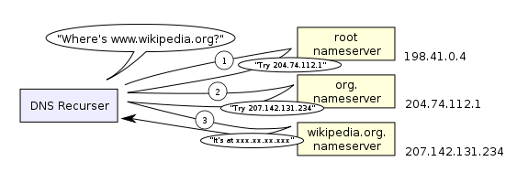
Resolving Names
http://en.wikipedia.org/wiki/File:An_example_of_theoretical_DNS_recursion.svg

Slide 18
Recursive vs. Iterative Queries
Recursive
Iterative
Less burden on query initiator
More burden on nameserver
Has to return an answer
Most root and TLD servers won’t answer (shed load)
Local name server answers recursive query
More burden on query initiator
Less burden on nameserver
Refers query to another nameserver

Slide 19
$ dig @a.root-servers.net www.freebsd.org +norecurse
;; Got answer:
;; ->>HEADER<<- opcode: QUERY, status: NOERROR, id: 57494
;; QUERY: 1, ANSWER: 0, AUTHORITY: 2, ADDITIONAL: 2
;; QUESTION SECTION:
;www.freebsd.org. IN A
;; AUTHORITY SECTION:
org. 172800 IN NS b0.org.afilias-nst.org.
org. 172800 IN NS d0.org.afilias-nst.org.
;; ADDITIONAL SECTION:
b0.org.afilias-nst.org. 172800 IN A 199.19.54.1
d0.org.afilias-nst.org. 172800 IN A 199.19.57.1
Time to live in seconds
Glue records

Slide 20
$ dig @199.19.54.1 www.freebsd.org +norecurse
;; Got answer:
;; ->>HEADER<<- opcode: QUERY, status: NOERROR, id: 39912
;; QUERY: 1, ANSWER: 0, AUTHORITY: 3, ADDITIONAL: 0
;; QUESTION SECTION:
;www.freebsd.org. IN A
;; AUTHORITY SECTION:
freebsd.org. 86400 IN NS ns1.isc-sns.net.
freebsd.org. 86400 IN NS ns2.isc-sns.com.
freebsd.org. 86400 IN NS ns3.isc-sns.info.
(authoritative for org.)

Slide 21
(authoritative for freebsd.org.)
$ dig @ns1.isc-sns.net www.freebsd.org +norecurse
;; Got answer:
;; ->>HEADER<<- opcode: QUERY, status: NOERROR, id: 17037
;; QUERY: 1, ANSWER: 1, AUTHORITY: 3, ADDITIONAL: 3
;; QUESTION SECTION:
;www.freebsd.org. IN A
;; ANSWER SECTION:
www.freebsd.org. 3600 IN A 69.147.83.33
;; AUTHORITY SECTION:
freebsd.org. 3600 IN NS ns2.isc-sns.com.
freebsd.org. 3600 IN NS ns1.isc-sns.net.
freebsd.org. 3600 IN NS ns3.isc-sns.info.
;; ADDITIONAL SECTION:
ns1.isc-sns.net. 3600 IN A 72.52.71.1
ns2.isc-sns.com. 3600 IN A 38.103.2.1
ns3.isc-sns.info. 3600 IN A 63.243.194.1

Slide 22



DNS Amplification Attack
x50 amplification
DNS query SrcIP: DoS Target
(60 bytes)
EDNS response
(3000 bytes)
Sven Olaf Kamphuis
DNS Server
and his “mobile computing office”
DoS Source
DoS Target
2006: 0.58M open resolvers on Internet (Kaminsky-Shiffman)
2013: 21.7M open resolvers (openresolverproject.org)
March 2013: 300 Gbps DDoS attack on Spamhaus

Slide 23
DNS Caching
Performing all these queries takes time
… before actual communication takes place
Caching can greatly reduce overhead
Top-level servers very rarely change
Popular sites visited often
How DNS caching works
All DNS servers cache responses to queries
Including negative responses (e.g., misspellings)
Responses include a time-to-live (TTL) field
Server deletes cached entry after TTL expires

Slide 24

Cached Lookup Example
Address of cs.cornell.edu nameserver cached
root & edu
nameservers
ftp.cs.cornell.edu
cornell.edu
nameserver
Local
recursive
resolver
ftp.cs.cornell.edu
Client
ftp=IPaddr
cs.cornell.edu
nameserver

Slide 25

The Coffee-Shop Attack
As you sip your latte and surf the Web, how does your laptop find google.com?
Answer: it asks the local DNS nameserver
… which is run by the coffee shop or their contractor
… and can return to you any answer they please
How can you know you’re getting correct data?

Slide 26
What if DNS Is Subverted?
Redirect victim’s web traffic to rogue servers
Redirect victim’s email to rogue email servers (MX records in DNS)
Does TLS/SSL provide protection?
Yes―user will get “wrong certificate” if SSL enabled
No―SSL not enabled or user ignores warnings
No―how is SSL trust established? Often, by email!

Slide 27
Pharming
Many anti-phishing defenses rely on DNS
Can bypass them by poisoning DNS cache and/or forging DNS responses
Browser: “give me the address of www.paypal.com”
Attacker: “sure, it’s 6.6.6.6” (attacker-controlled site)
Dynamic pharming / DNS rebinding
Provide bogus DNS mapping for a trusted server, trick user into downloading a malicious script
Force user to download content from the real server, temporarily provide correct DNS mapping
Malicious script and content have the same origin!
Why?

Slide 28



DNS Rebinding for an Intranet Attack
Good.net
Lookup www.evil.org
DNS
Why is this access permitted?
222.33.44.55
– short ttl
script
GET /, host www.evil.org
Evil.org
origin: evil.org
access evil.org
DNS
Lookup www.evil.org
intra.good.net
10.0.0.7
10.0.0.7

Slide 29
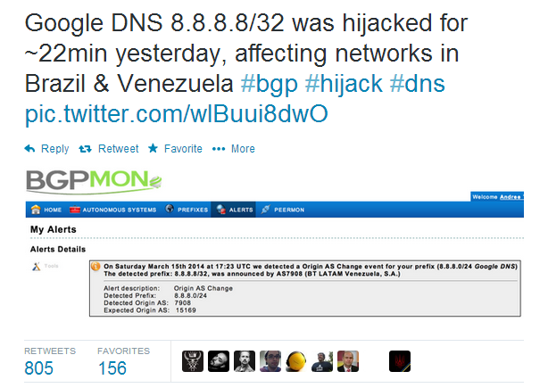
March 16, 2014
It is suspected that hackers exploited a well-known vulnerability in the so-called Border Gateway Protocol (BGP)

Slide 30
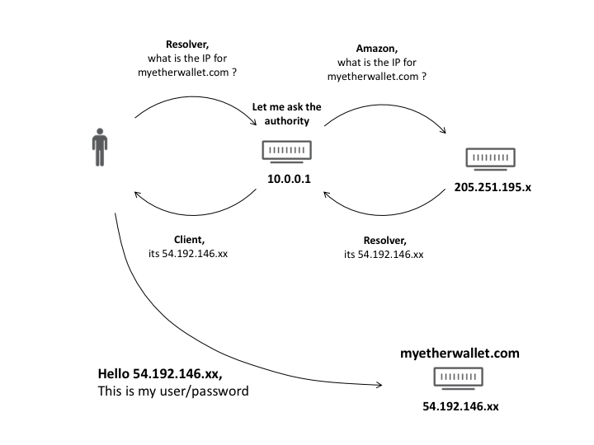
Amazon DNS Hijack via BGP Hijack (2018)
This IP space is
allocated to Amazon
Instead, routes to it were announced by eNet and forwarded to Hurricane Electric
https://blog.cloudflare.com/bgp-leaks-and-crypto-currencies/

Slide 31
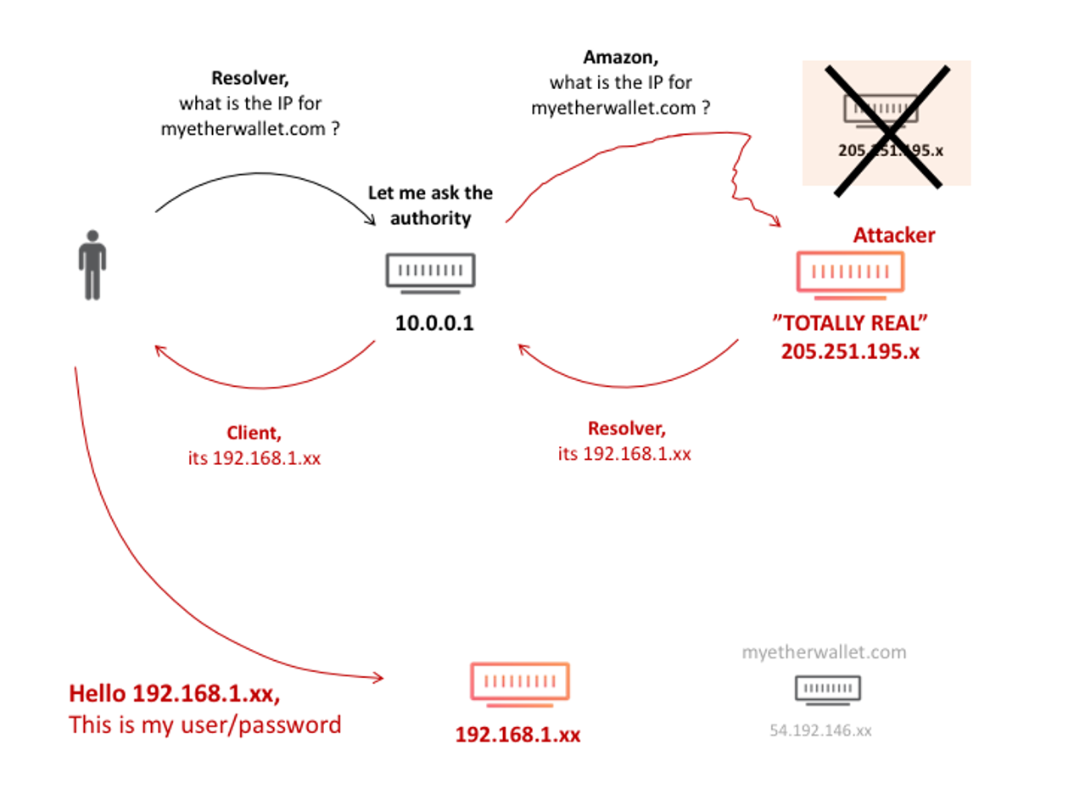
Amazon DNS Hijack via BGP Hijack (2018)
$150K worth of cryptocurrency stolen
https://blog.cloudflare.com/bgp-leaks-and-crypto-currencies/

Slide 32
DNS “Authentication”
Request contains random 16-bit TXID
root & edu
DNS servers
www.cs.cornell.edu
www.cs.cornell.edu
NS cornell.edu
cornell.edu
DNS server
Local
DNS recursive
resolver
Response accepted if TXID is the same,
stays in cache for a long time (TTL)
NS cs.cornell.edu
Client
www=IPaddr
cs.cornell.edu
DNS server

Slide 33
DNS Spoofing by Off-Path Attacker
How is this different from the coffee-shop scenario?
6.6.6.6
Trick client into looking up host1.foo.com (how?)
Guess TXID, host1.foo.com is at 6.6.6.6
Another guess, host1.foo.com is at 6.6.6.6
Another guess, host1.foo.com is at 6.6.6.6
host1.foo.com
TXID, host1.foo.com
Local
resolver
ns.foo.com
DNS server
Client
host1.foo.com is at 1.2.3.4
Several opportunities to win the race.
If attacker loses, has to wait until TTL expires…
… but can try again with host2.foo.com, host3.foo.com, etc.
… but what’s the point of hijacking host3.foo.com?

Slide 34
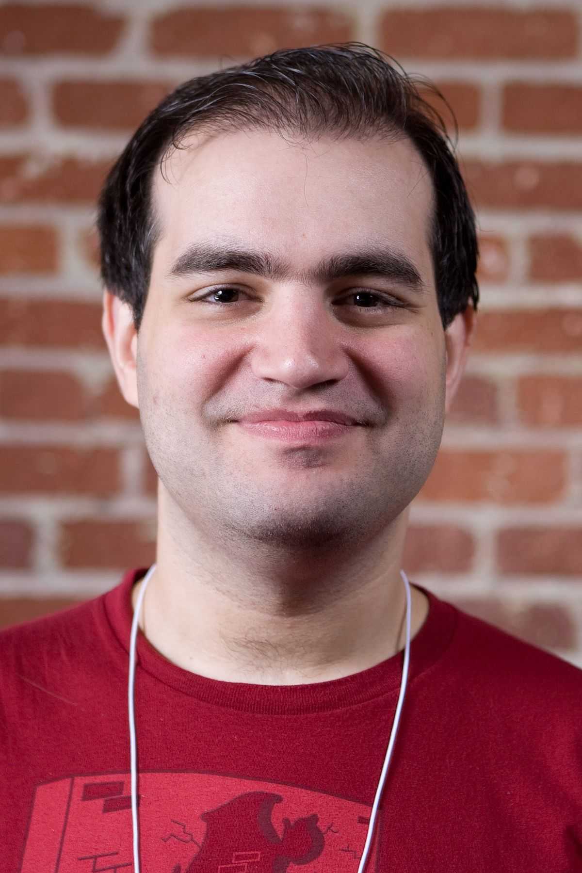
Kaminsky’s Attack
6.6.6.6
Trick client into looking up host1.foo.com
Guessed TXID + very long TTL
I don’t know where host1.foo.com is, but
ask the authoritative server at ns2.foo.com
It lives at 6.6.6.6
host2.foo.com
host1.foo.com
TXID, host1.foo.com
Local
resolver
ns.foo.com
DNS server
Client
host1.foo.com is at 1.2.3.4
If win the race, any request for XXX.foo.com will go to 6.6.6.6
The cache is poisoned… for a very long time!
No need to win future races!
If lose, try again with <ANYTHING>.foo.com

Slide 35
Triggering a Race
Any link, any image, any ad, anything can cause a DNS lookup
No JavaScript required, though it helps
Mail servers will look up what bad guy wants
On first greeting: HELO
On first learning who they’re talking to: MAIL FROM
On spam check (oops!)
When trying to deliver a bounce
When trying to deliver a newsletter
When trying to deliver an actual response from an actual employee

Slide 36
Reverse DNS Spoofing
Trusted access is often based on host names
Example: permit all hosts in .rhosts to run remote shell
Network requests such as rsh or rlogin arrive from numeric source addresses
System performs reverse DNS lookup to determine requester’s host name and checks if it’s in .rhosts
If attacker can spoof the answer to reverse DNS query, he can fool target machine into thinking that request comes from an authorized host
No authentication for DNS responses and typically no double-checking (numeric → symbolic → numeric)

Slide 37

Solving the DNS Spoofing Problem
Long TTL for legitimate responses
Does it really help?
Randomize port in addition to TXID
32 bits of randomness, makes it harder for attacker to guess TXID+port
DNSSEC
Cryptographic authentication of host-address mappings
Encrypted DNS
Not the same!
DNSSEC does not encrypt DNS requests and responses.

Slide 38
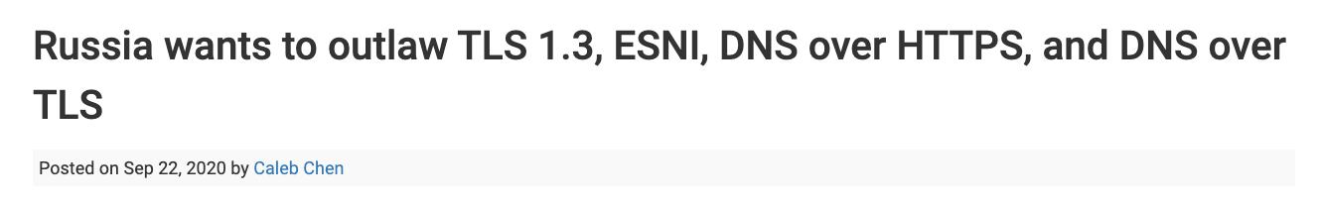
[draft law] “… bans the use of encryption protocols allowing for hiding the name (identifier) of a web page or Internet site on the territory of the Russian Federation.”

